Slide 1
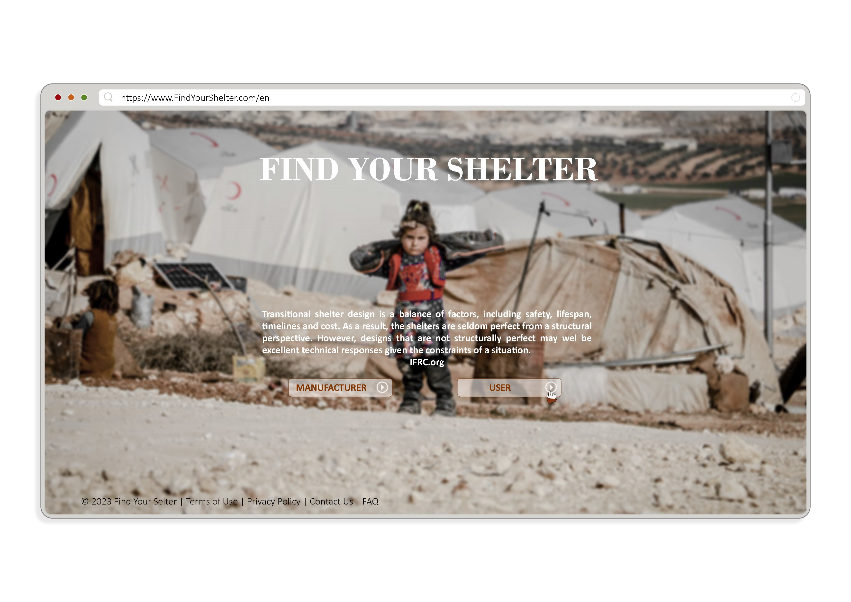
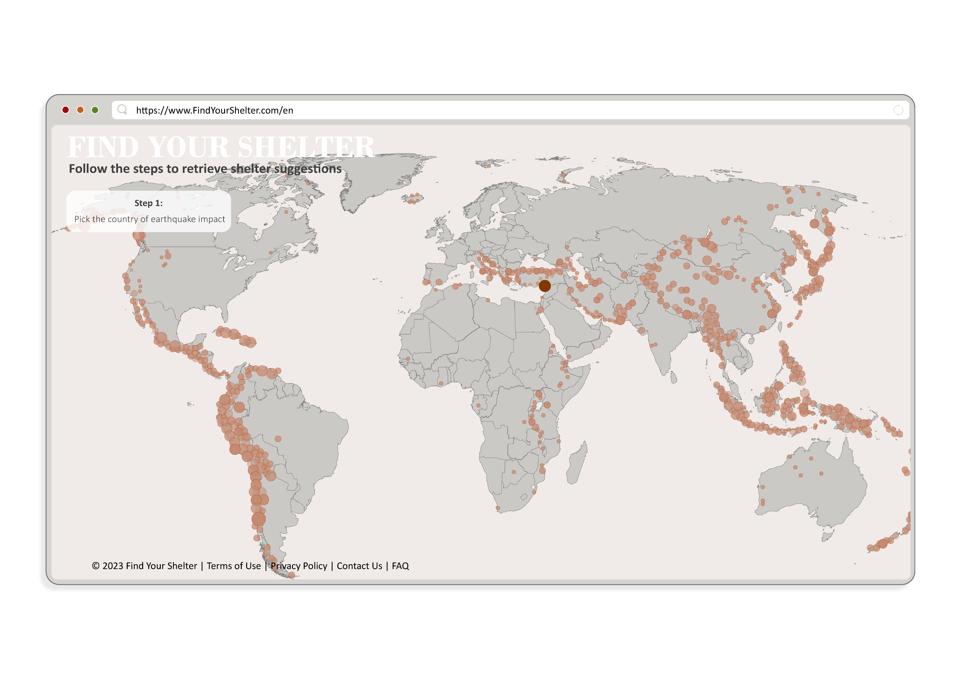


Notes:
Hello, this is Find Your Shelter,

Slide 2
Find Your Shelter
An information-driven framework to increase efficiency in site-specific shelter decision making process.
Sasipa Vichitkraivin, Dimitra Mountaki, Maartje Damen | CORE AR3B012 | November 2023
Notes:
an information-driven framework to increase efficiency in site-specific shelter decision making process.

Slide 3
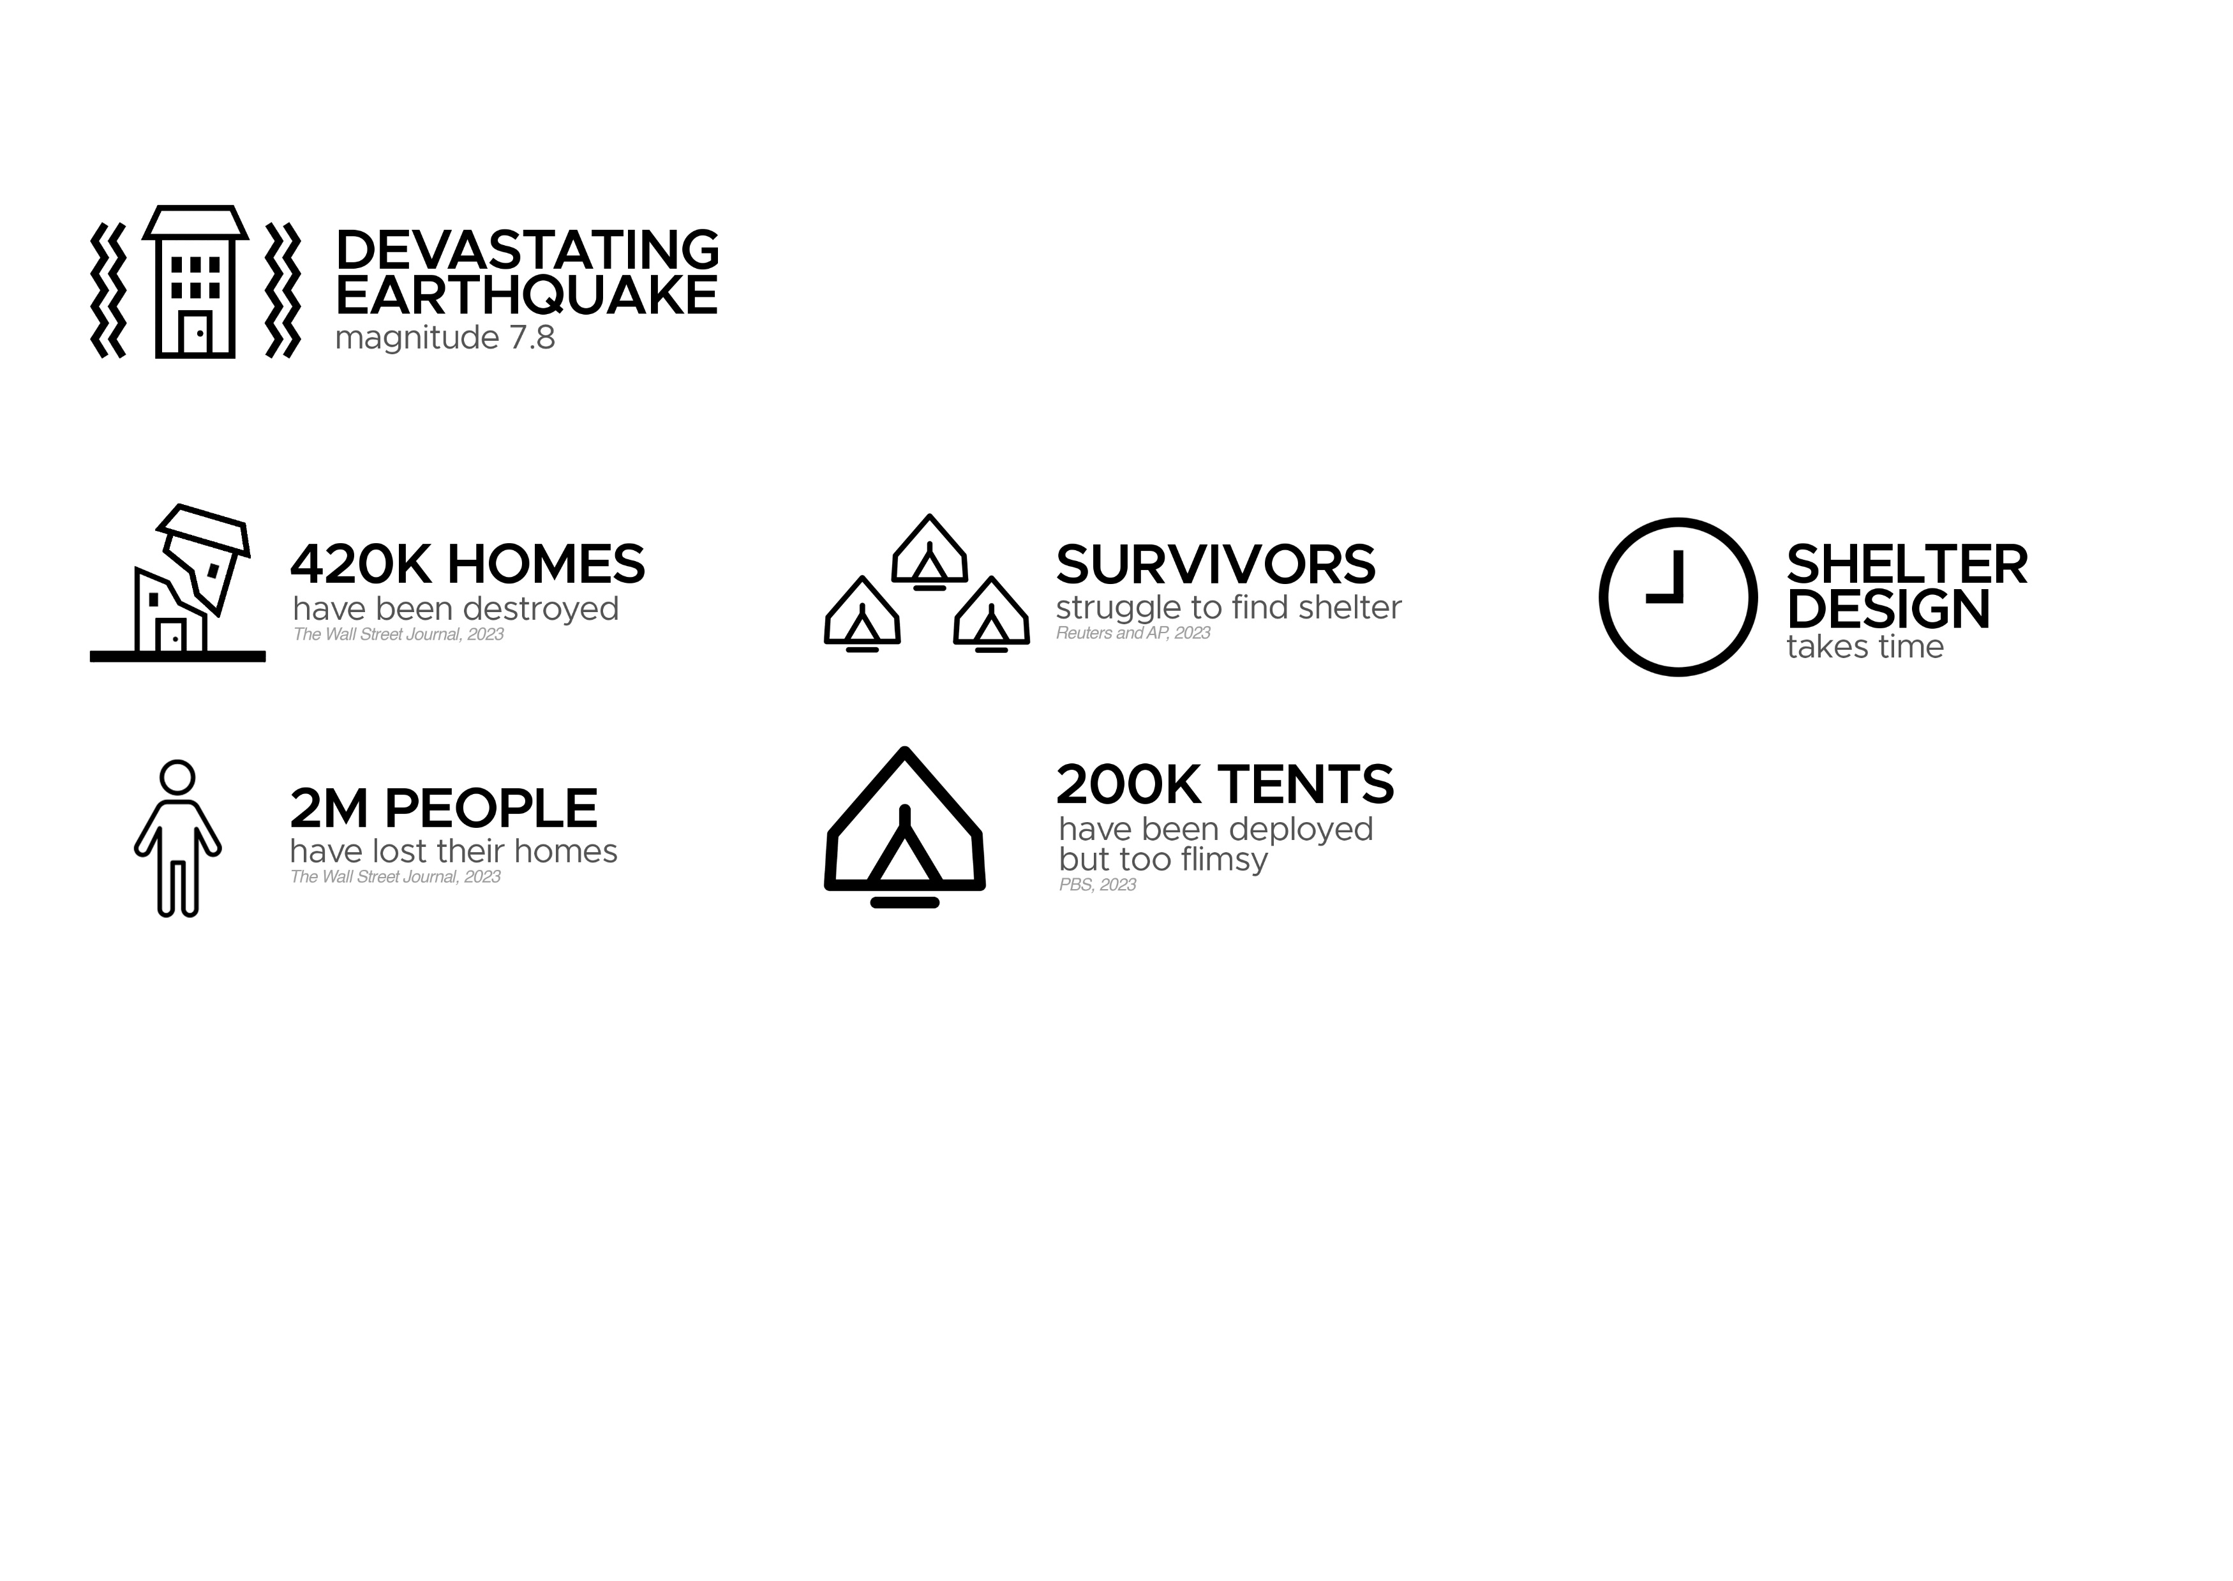

Find Your Shelter
Notes:
For this app we use the context of the situation of the earthquake in Turkey and Syria, where four hundred twenty thousand people lost their homes, and there was a big struggle to find shelter. Shelter design takes time, and in situations like this every form of delay results in longer suffering for the refugees.

Slide 4
Bringing suitable shelters to the places they are needed the most
Notes:
With Find your Shelter, we can help shorten the time it takes between the earthquake and the supply of adequate shelters for those in need.

Slide 5
Find Your Shelter
Notes:
(wait a few seconds)

Slide 6
Find Your Shelter
How can a decision support tool help shorten the time between an earthquake and the supply of adequate (semi-permanent) shelters?
How does this tool bridge the gap between the available knowledge of shelters and the time limit that impacts the shelter allocation decision?
How can this tool suggest shelters that provide adequate protection and quality of life for a shelter site, from a structural, comfort and cultural perspective?
Notes:
How can a decision support tool help shorten the time between an earthquake and the supply of adequate (semi-permanent) shelters?

Slide 7
Find Your Shelter
The design objectives:
Minimize the time it takes between the availability of (financial) resources to the provision of shelters.
Make existing shelter knowledge easily available and useable.
Help find the shelter design that is technically most appropriate for the location that it is needed for.
Notes:
We aim to do this by making existing shelter knowledge and design more easily available, and by using location-specific information to do suggestions of appropriate shelter options.

Slide 8
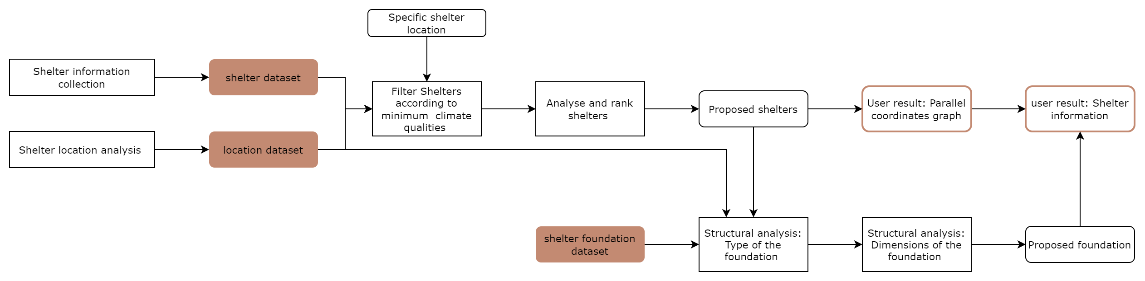
The process
Notes:
The computational process consists out of 3 main steps: The generation of the datasets, the analysis of the shelter types and the structural analysis of the foundation.

Slide 9
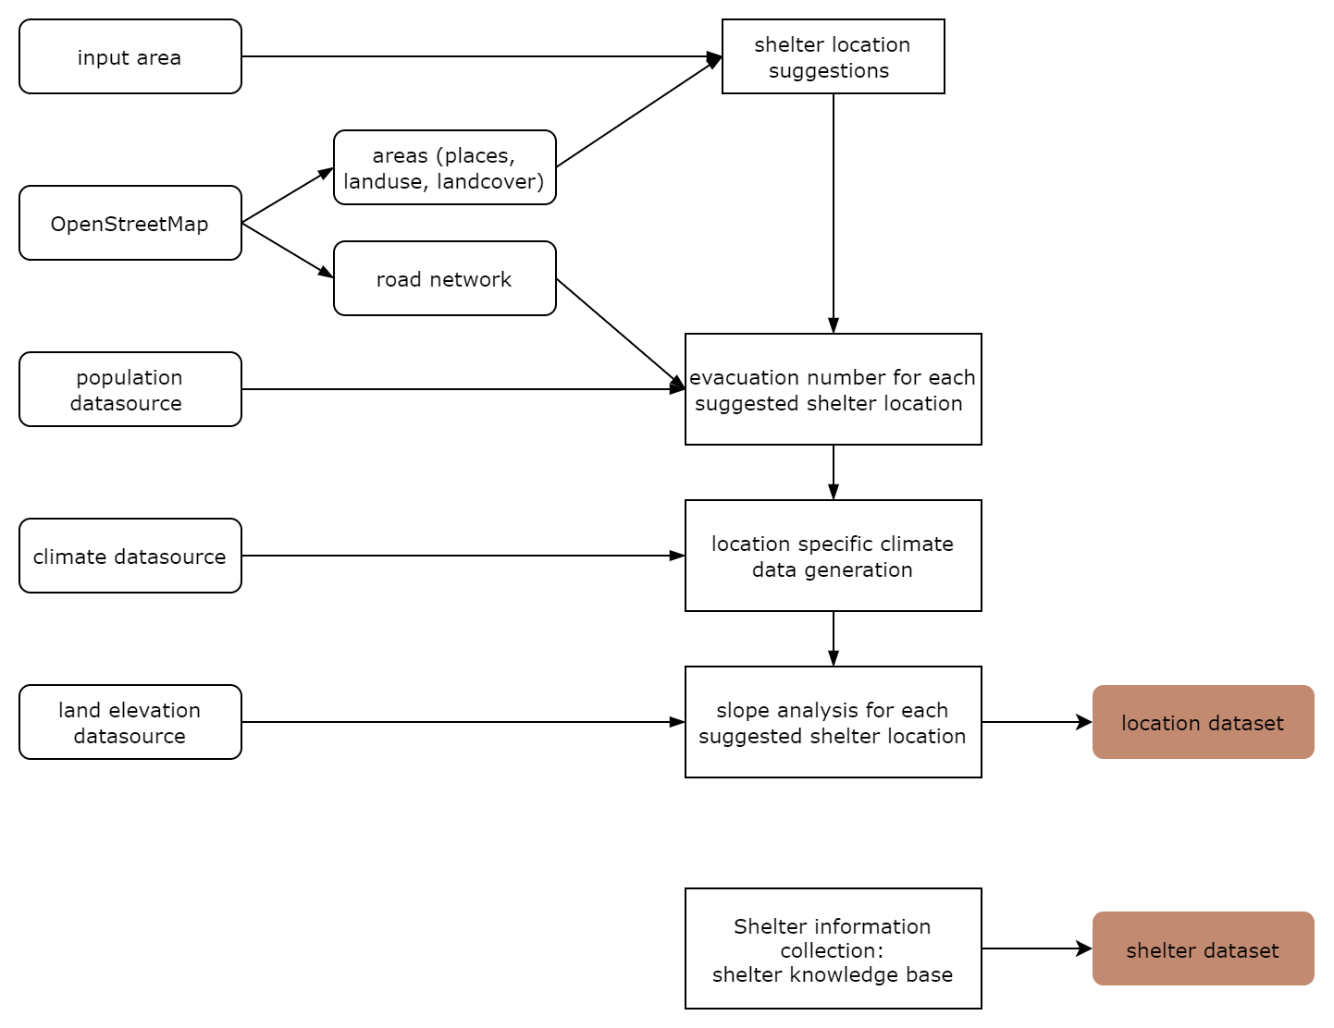
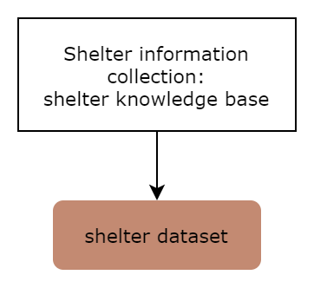
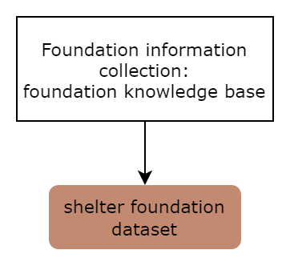
The process: Datasets
Notes:
The shelter dataset is a database consisting out of existing shelter designs. By collecting the designs that have been put into use, existing knowledge can be a contribution to the shelter decision. The same applies for the foundation dataset.
The location dataset is generated based on a variety of data sources that impact the quality of the location. For this tool, we chose to use the area types, the road network, the population data, climate data and elevation data.

Slide 10
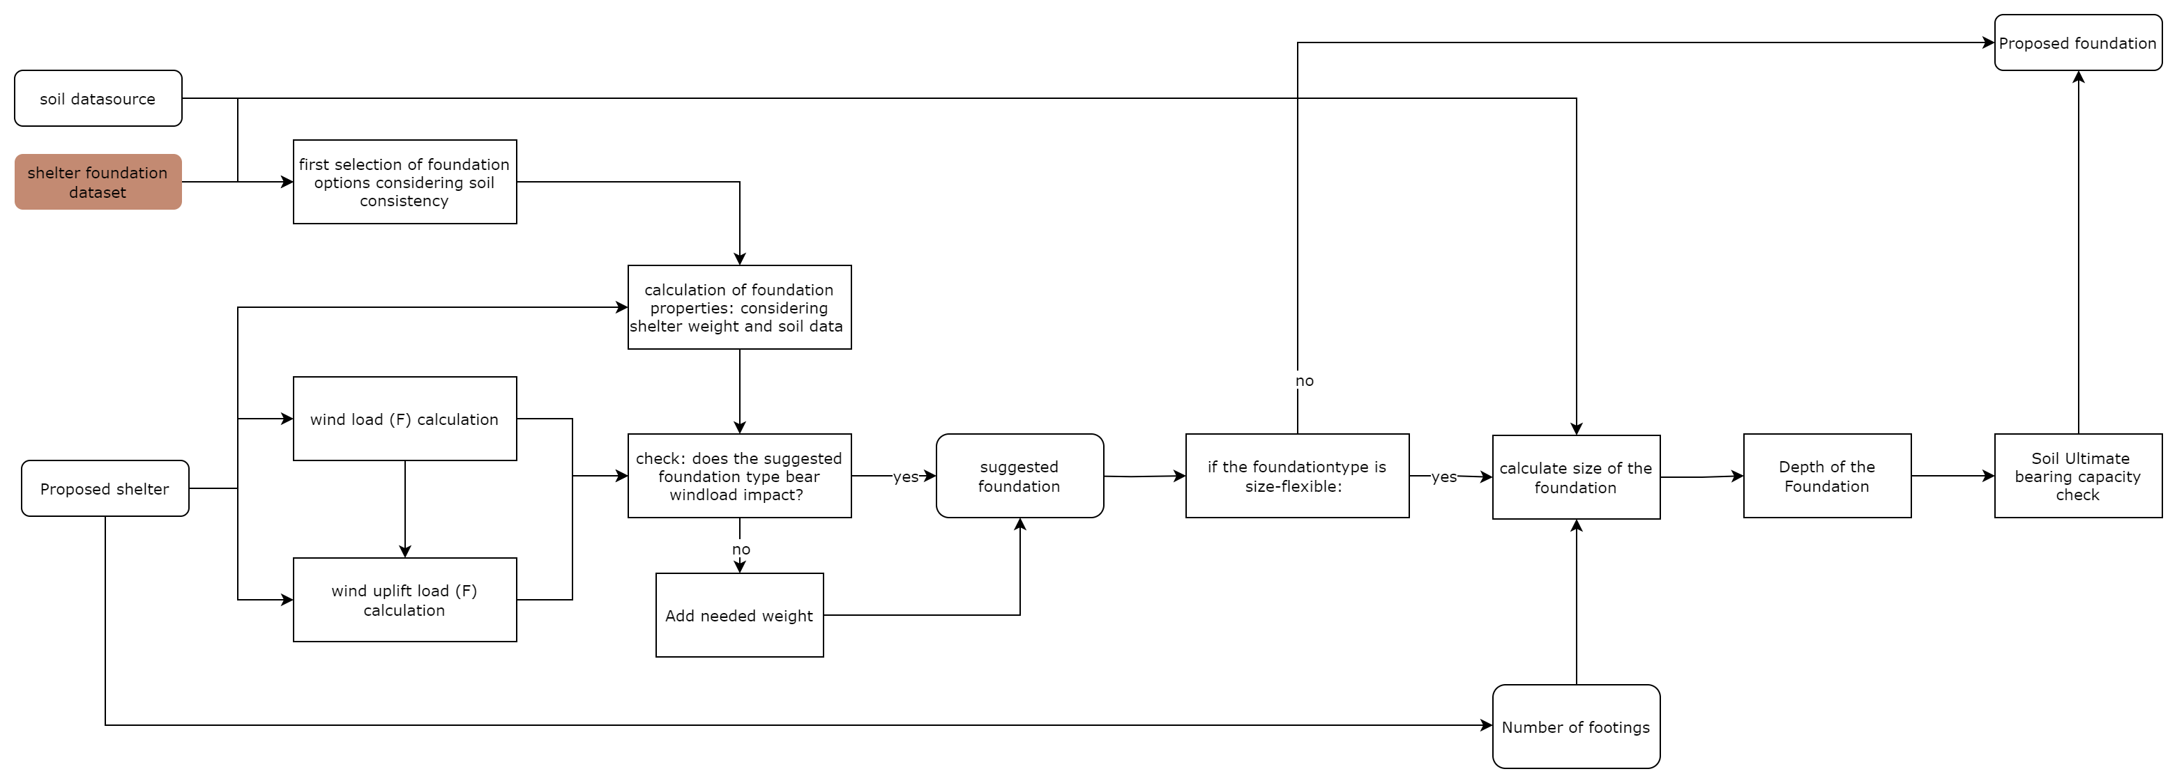
The process: structural analysis
Notes:
For the foundation suggestion, we analyse the soiltype based on consistency, and select based on the ease of digging, screwing or pegging. We filter for the windload uplift, and for flexible foundations we calculate the size. After checking the soil load bearing, we propose a foundation.

Slide 11
The process
Notes:
This all leads to the user retrieving good shelter options for their suggested location.

Slide 12
Notes:
The website would look like this and is both useful for the manufacturer and the user. If you are a manufacturer or a shelter designer, you can add your shelter information to the website, so that people can find it if it suits their needs.

Slide 13
Notes:
We now focus on the user. You pick the disaster that you are impacted by,

Slide 14
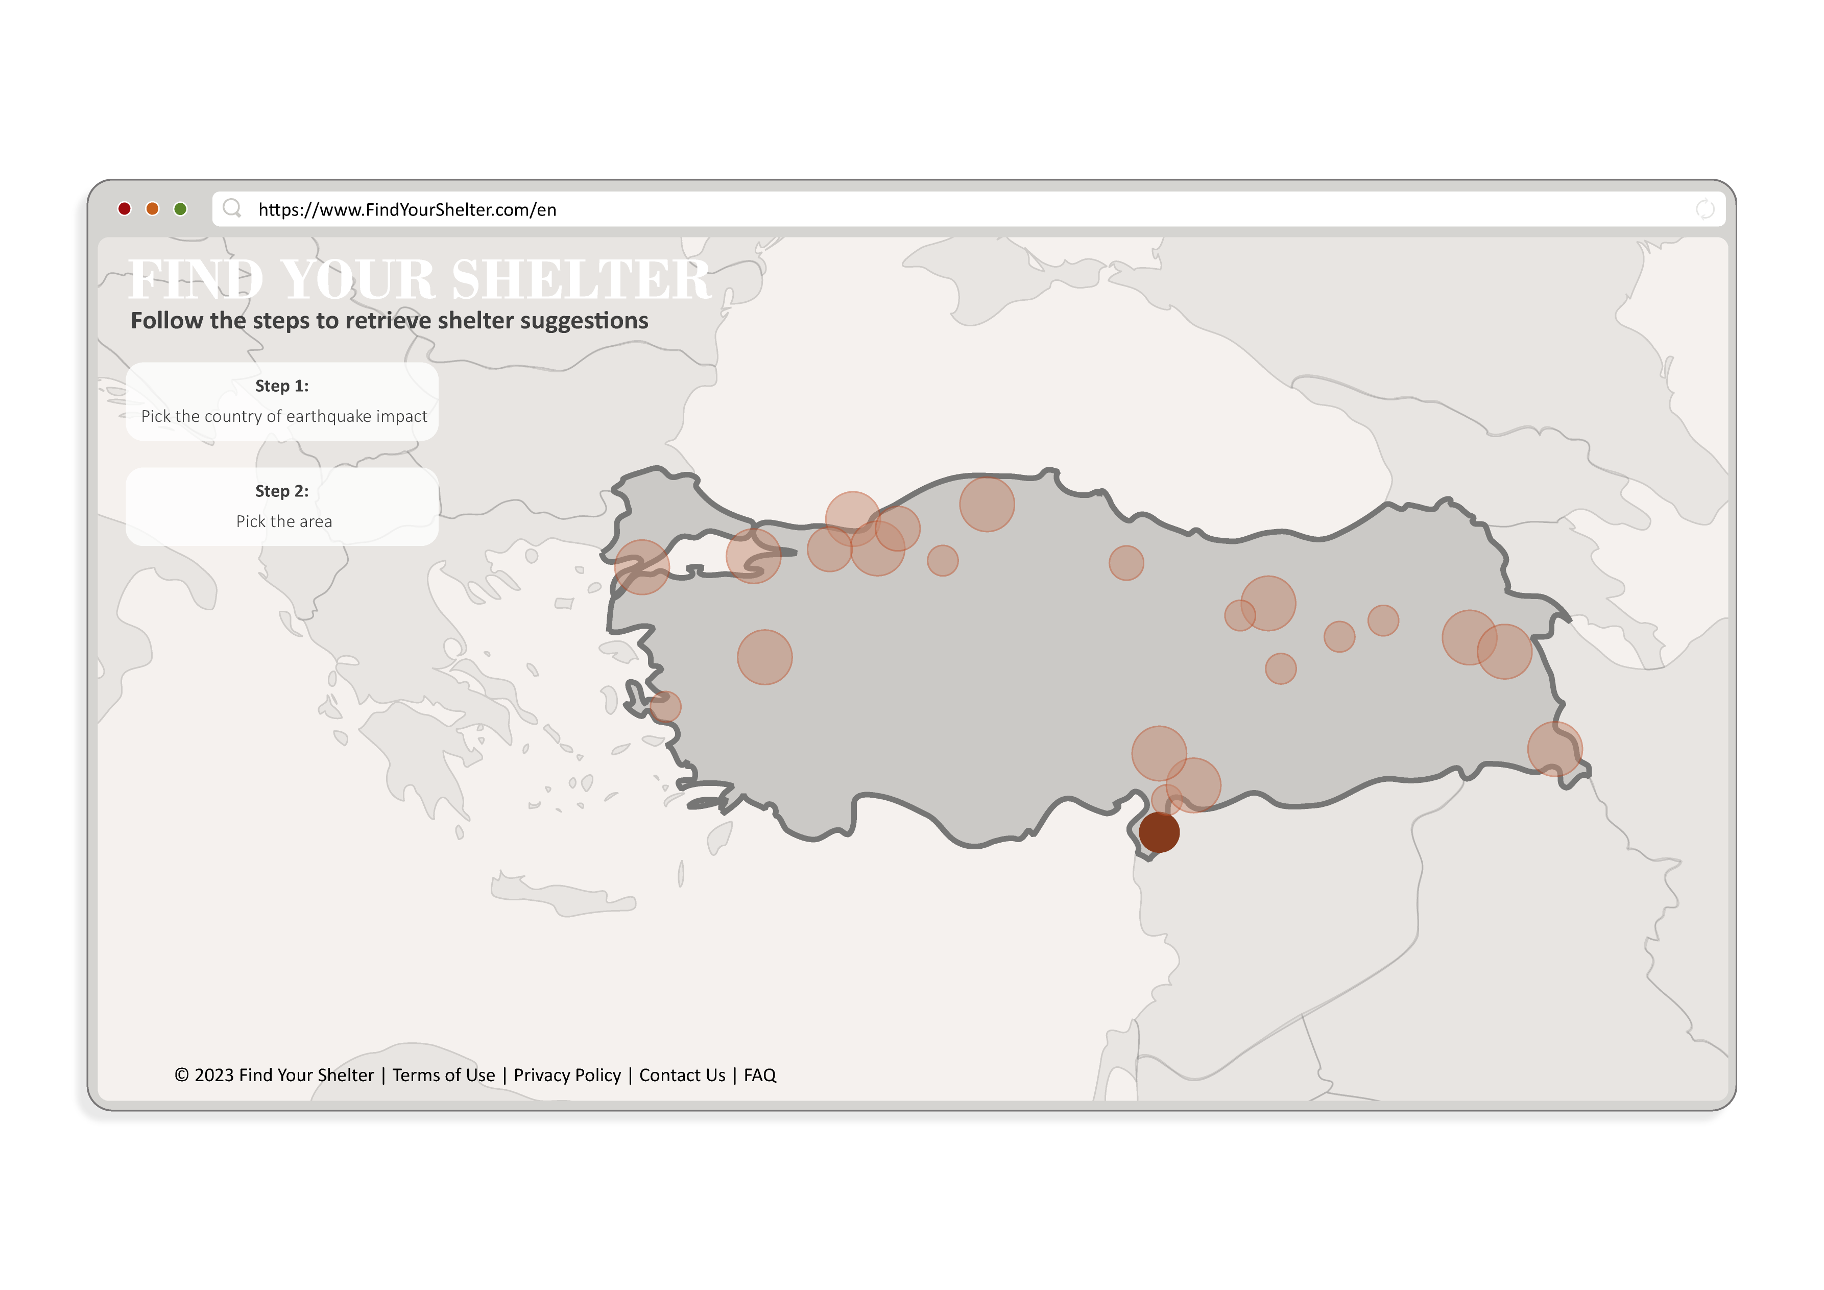
Notes:
and select your area of interest.

Slide 15
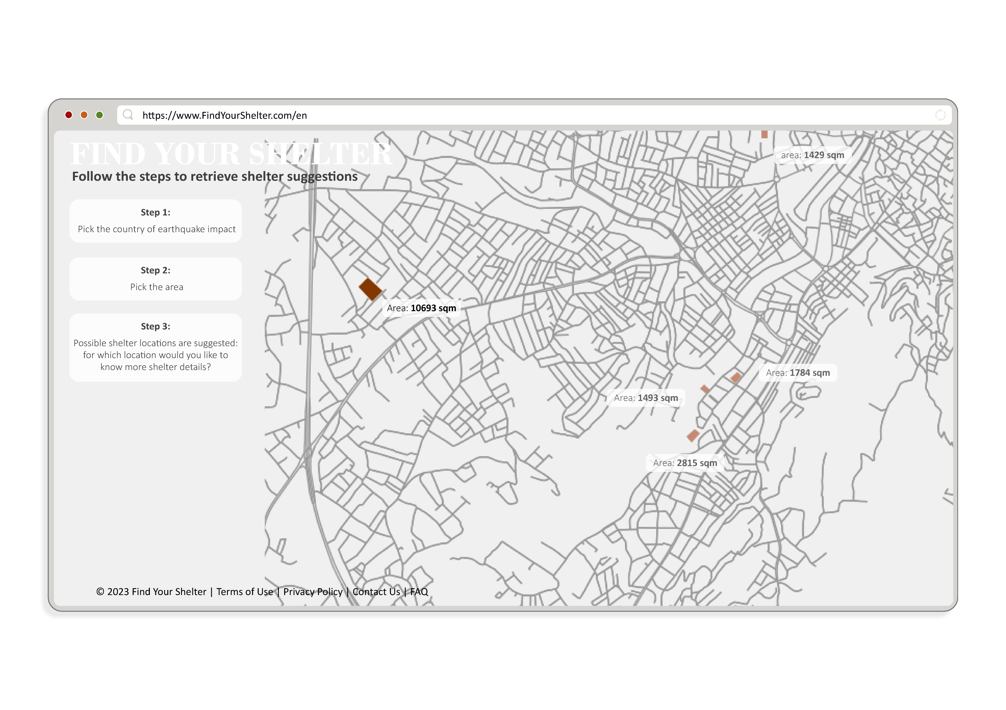
Notes:
For this area, different shelter locations are suggested. By choosing a shelter area, the analysis is being executed.

Slide 16
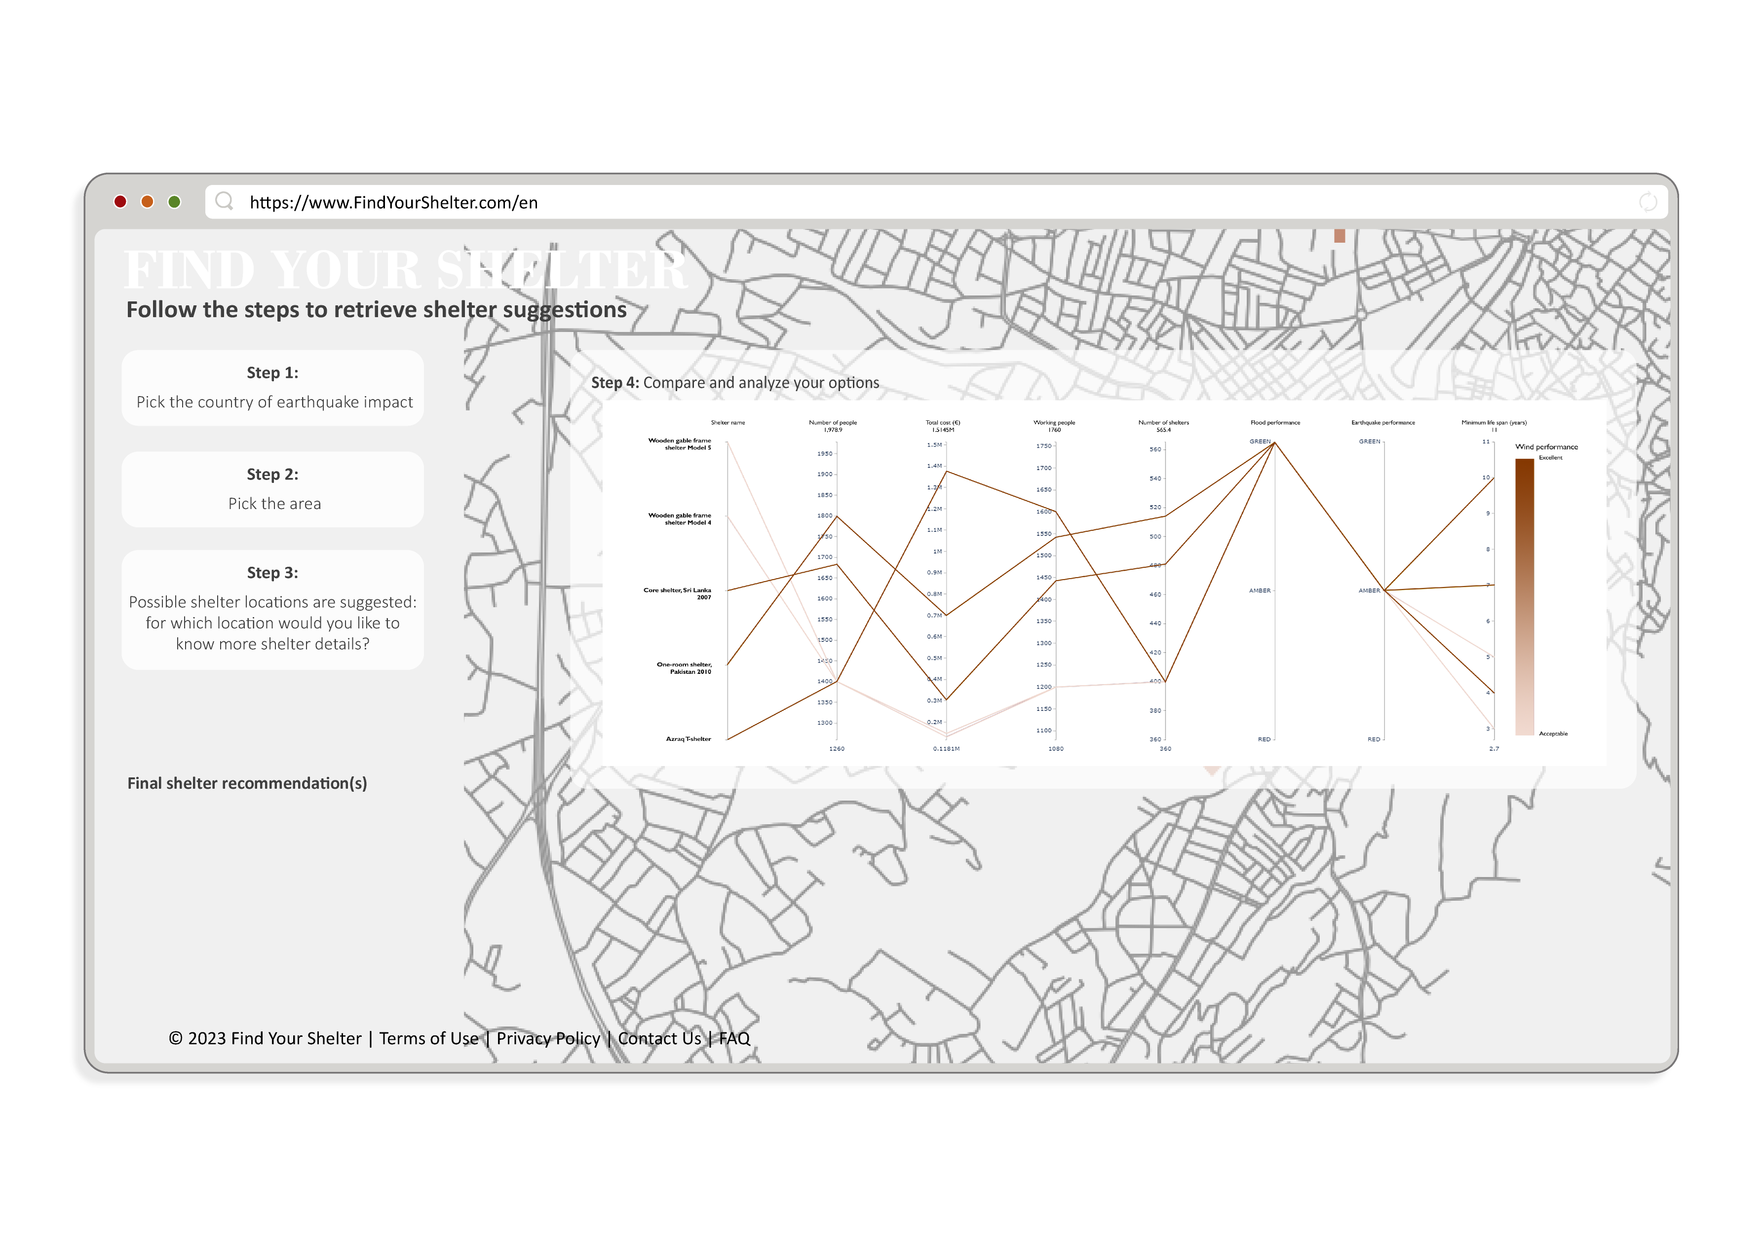
Notes:
The tool selects the shelters that are possible to place in this area based on the SPHERE handbook and visualizes the different performances that each shelter does well on in a graph. CLICK you can scroll through all options and click on the shelter that suits your preferences.

Slide 17
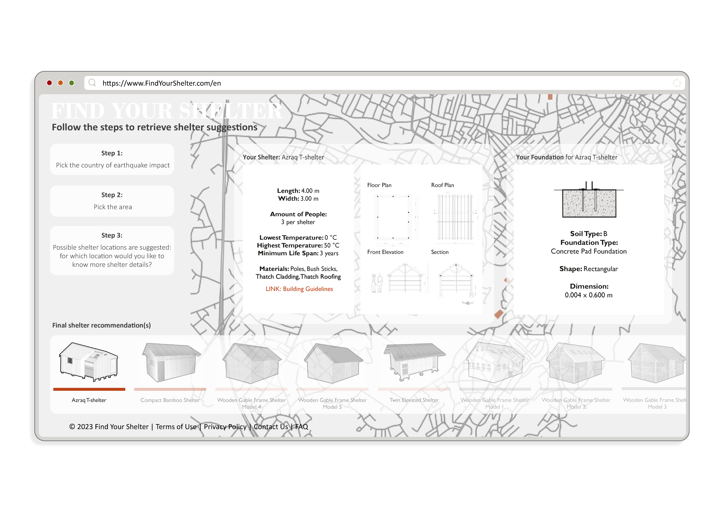
Notes:
For this shelter, relevant information is shown, and a foundation type is suggested based on selfload, windload and soiltype of the location. A link is provided with further information of the specific shelter.

Slide 18
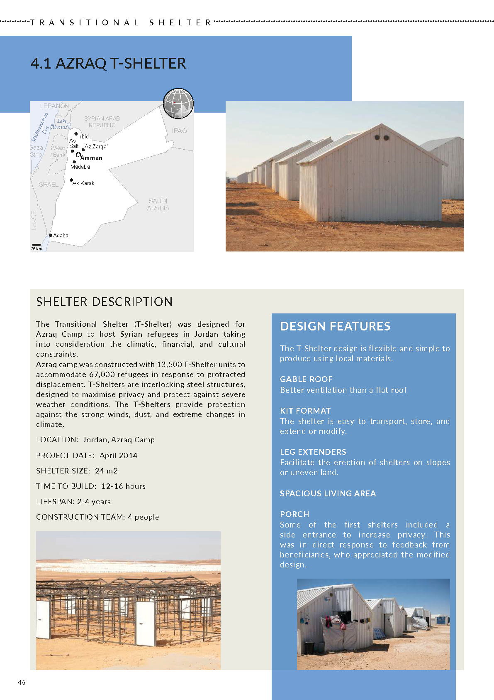
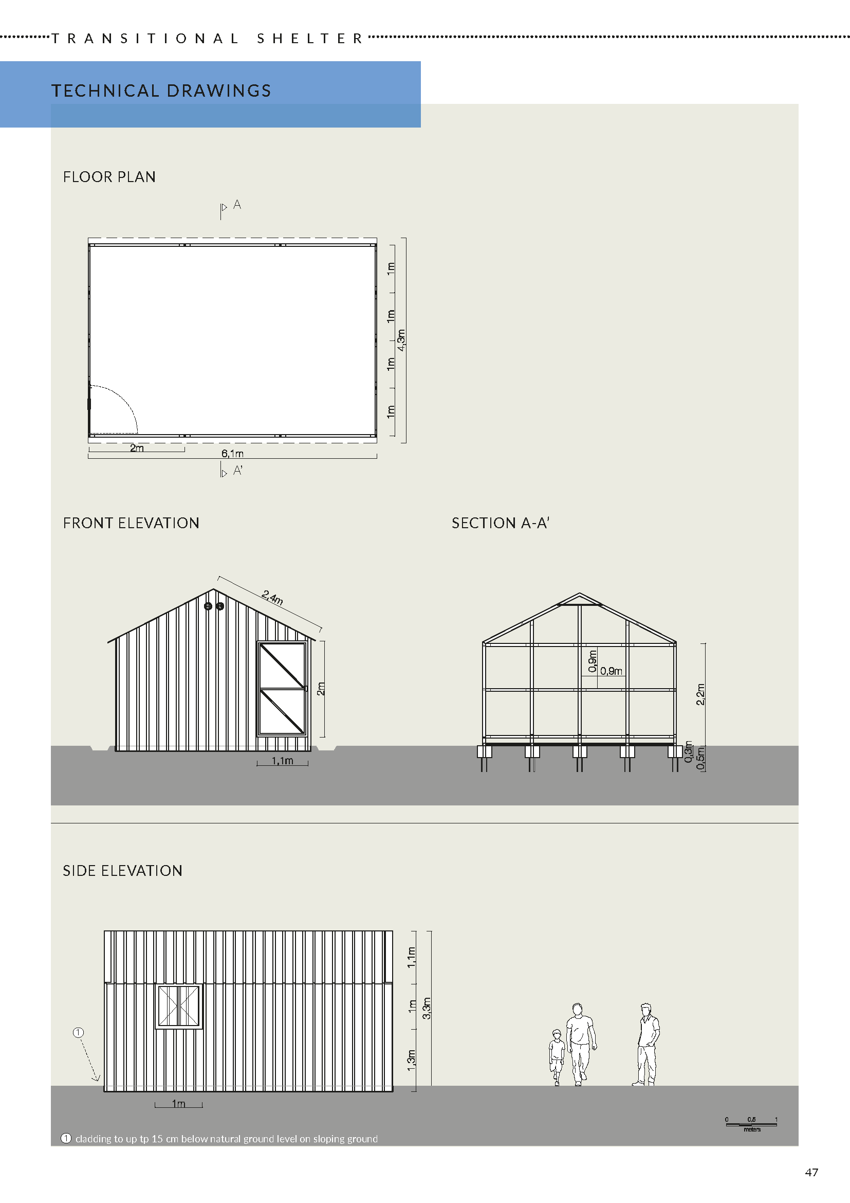
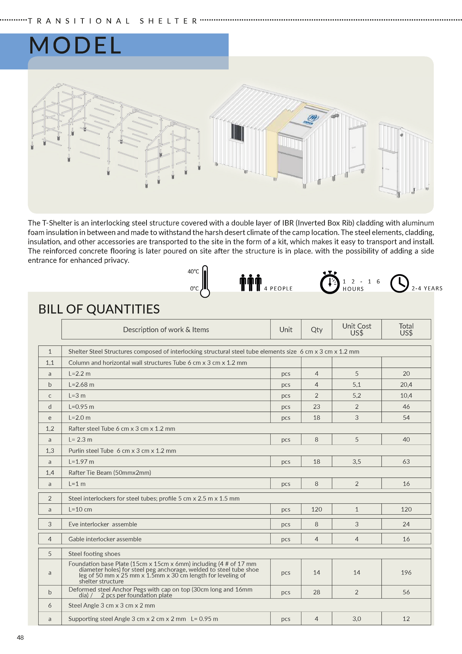
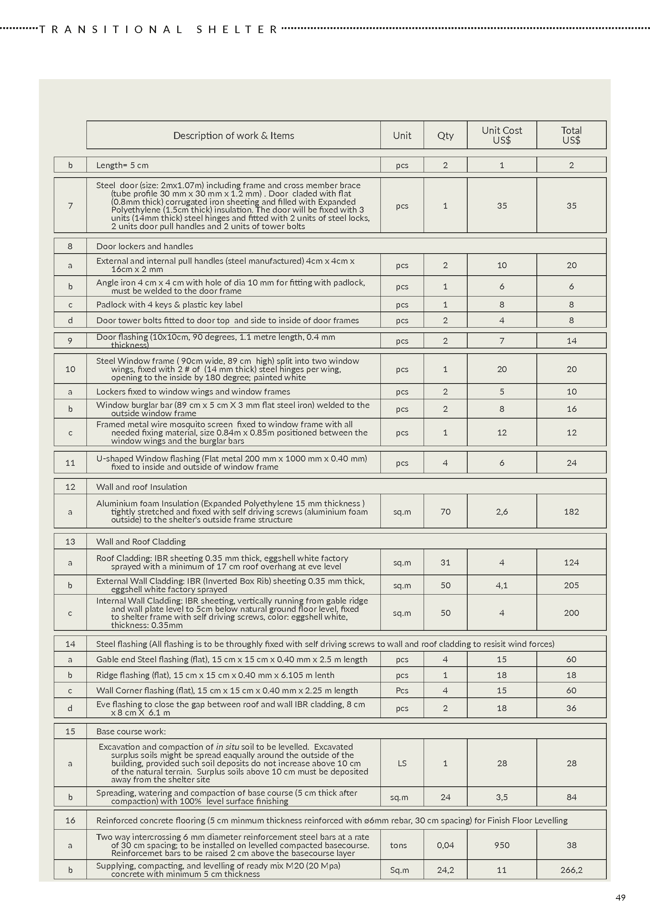
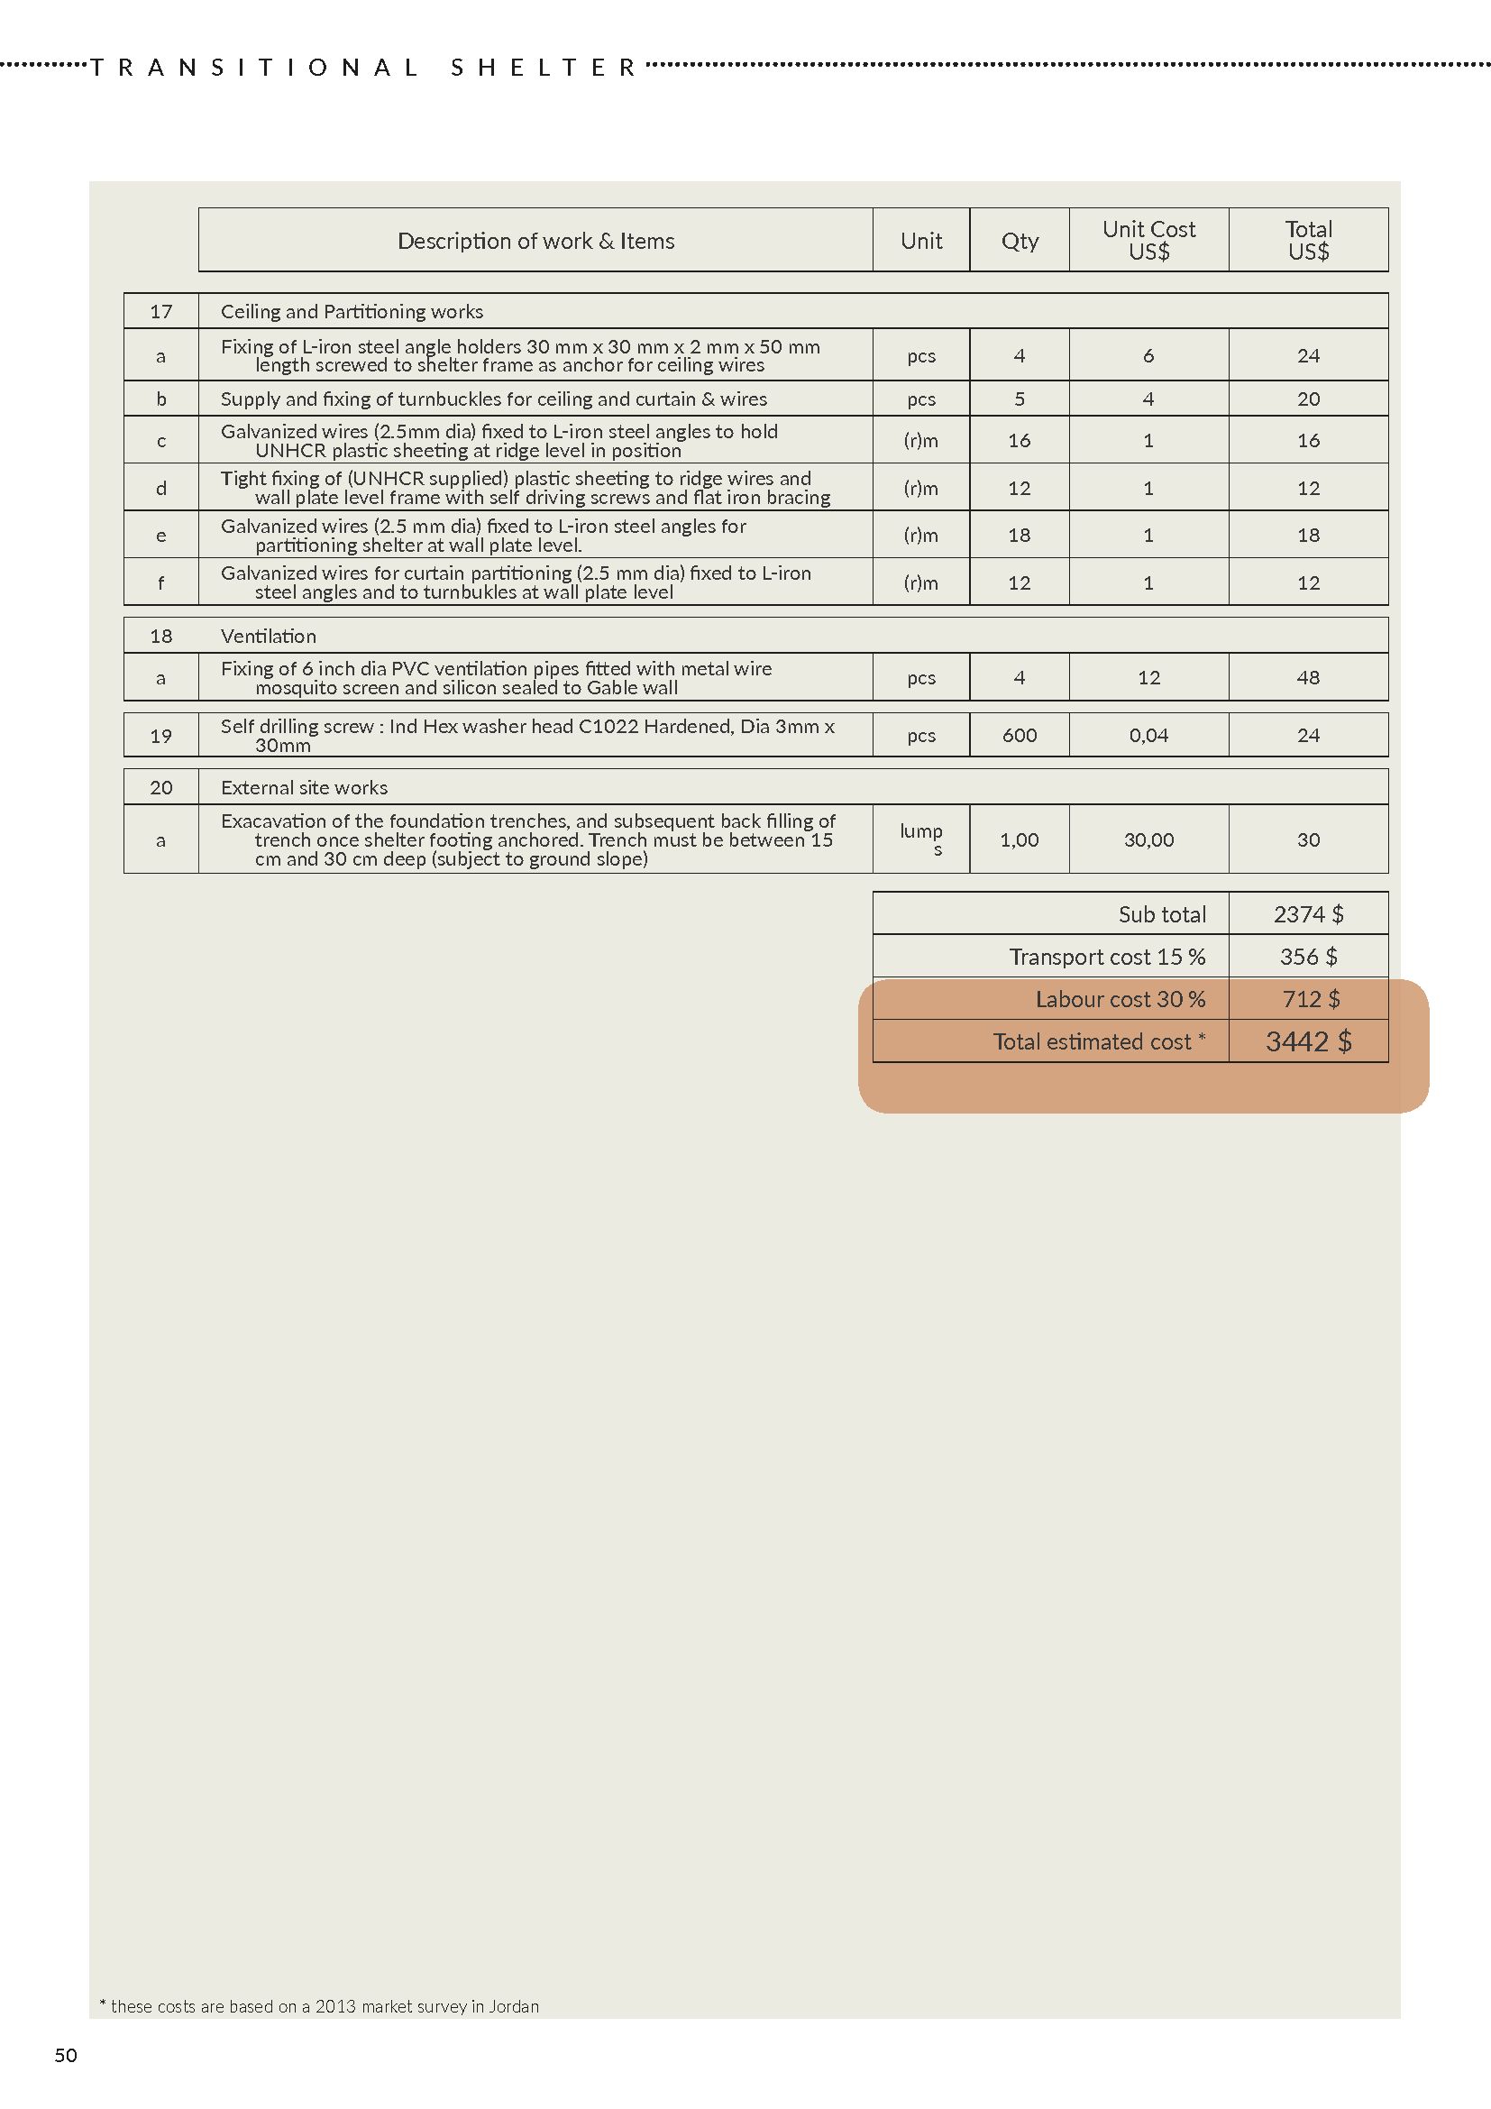
Notes:
(automated)

Slide 19
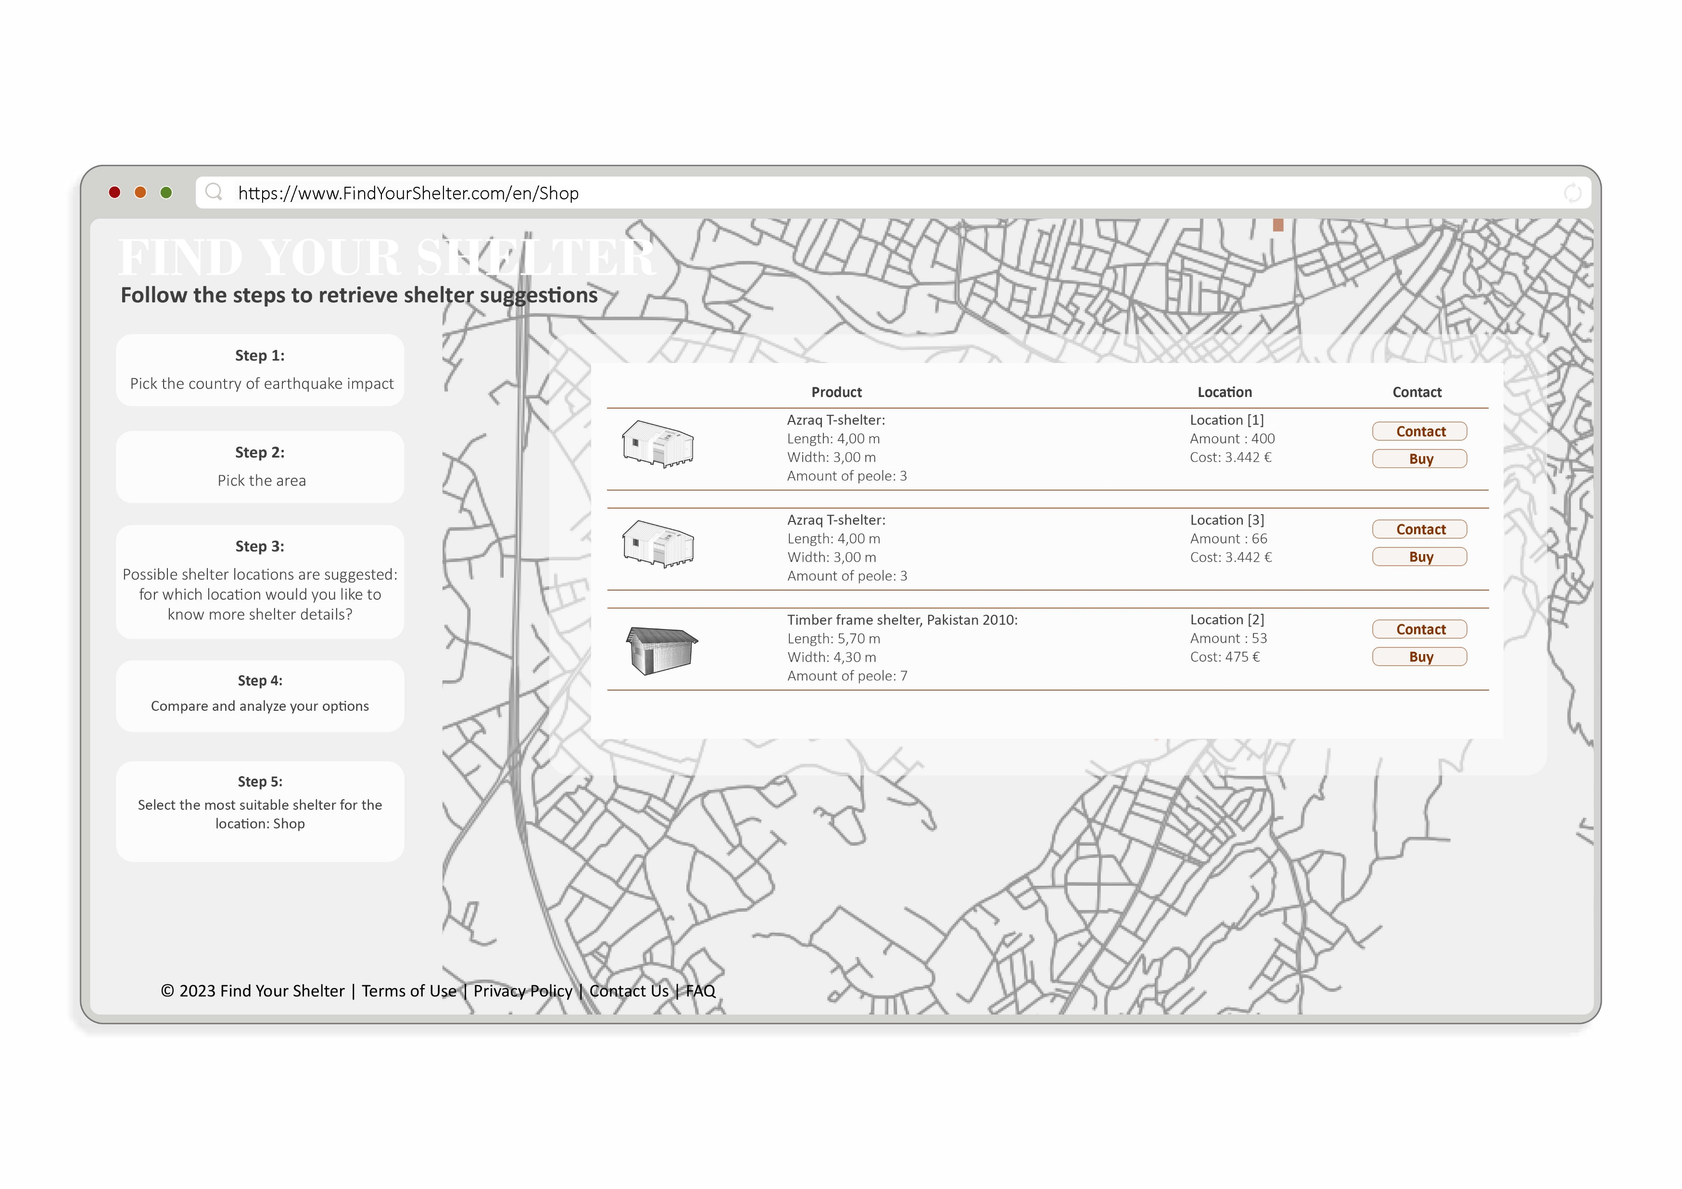
Notes:
At the conclusion of the selection process, the user has the option to choose a shelter based on their preferred location. CLICK Subsequently, they may opt to initiate contact with the manufacturer to inquire further about the shelter, (CLICK) including details regarding its specifications and the estimated time required for transportation to their country.

Slide 20
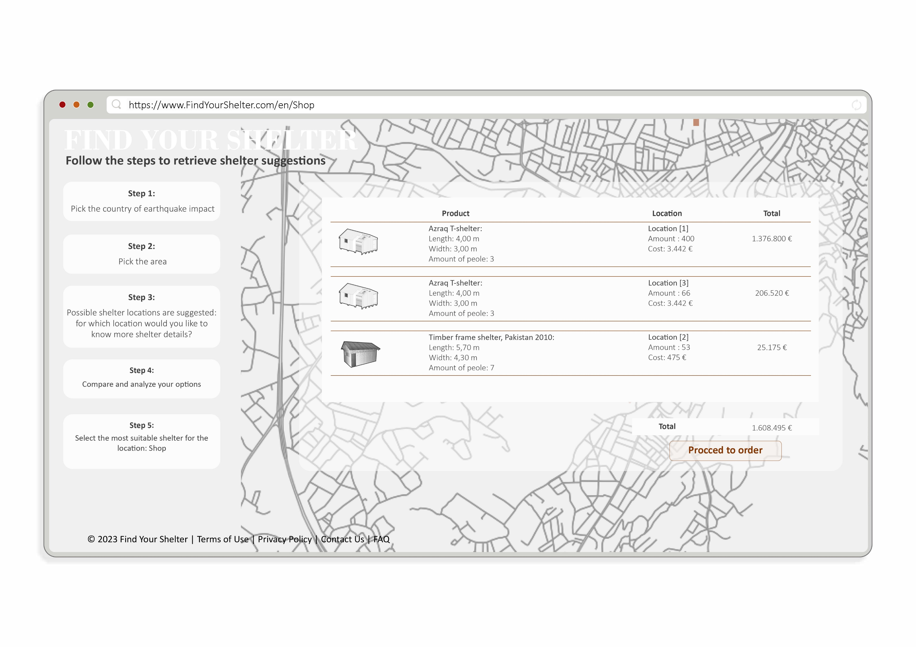
Notes:
Alternatively, they can make a direct purchase.

Slide 21
Find Your Shelter
An information-driven framework to increase efficiency in site-specific shelter decision making process.
Sasipa Vichitkraivin, Dimitra Mountaki, Maartje Damen | CORE AR3B012 | November 2023
Notes:
With these suggestions, this tool can help shorten the time of shelter decision making, by removing the need of (re)designing a shelter and providing available shelter knowledge in a streamlined environment.

Slide 22
Thank you.
Notes:
Thank you for your attention.

